Slide 1




OLIST STORE
SALES ANALYSIS
Presented by: Salwa Sayed

Slide 2

01
02
03
Data Profile
Tables
Data Modling
04
05
OVERVIEW
Business Questions
Analysis and Visuals
06
07
Insights
Recommendations

Slide 3



01
DATA PROFILE
This is a Brazilian e-commerce public dataset of orders made at Olist Store. The dataset has information of 100k orders from 2016 to 2018 made at multiple marketplaces in Brazil. Its features allow viewing order from multiple dimensions: from order status, price, payment, and freight performance to customer location and product attributes

Slide 4
02
TABLES
01
olist_order_items_dataset
02
olist_order_payment
03
olist_sellers_dataset
04
olist_orders_dataset
05
olist_customers_dataset
06
product_category

Slide 5
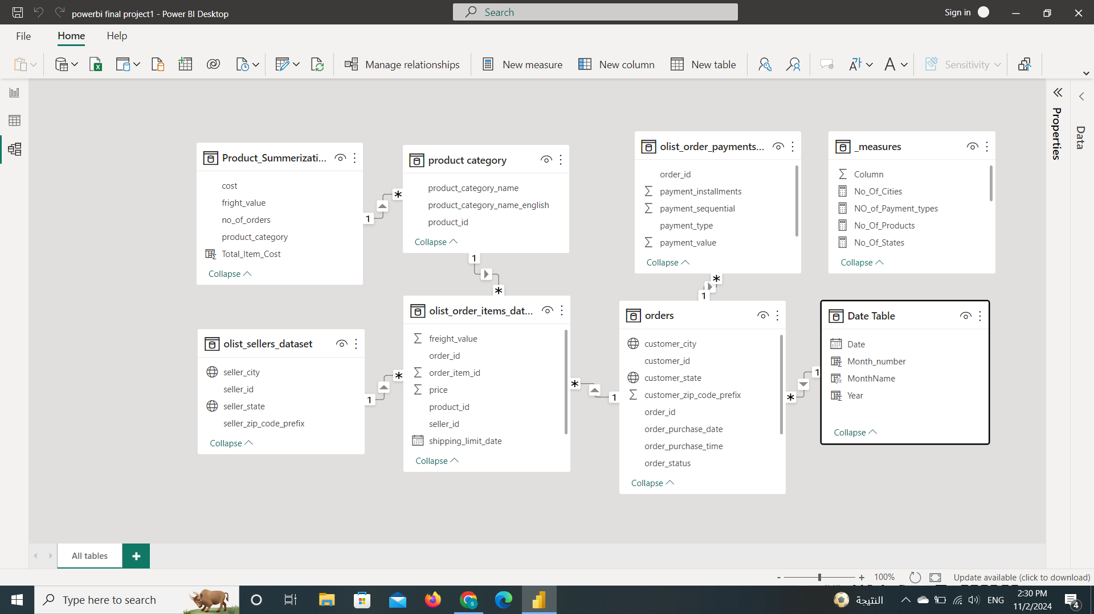
03
DATA MODLING

Slide 6



Q1
4.1
What was the most and less profitable product category?
Q2
BUSINESS QUESTIONS
Who were the 3 top customers purchased from our store?
Q3
Who were the 3 best sellers made the biggest number of orders ?

Slide 7
Q4
4.2
Which city that had the biggest number of orders ?
Q5
BUSINESS QUESTIONS
Which state that made the highest revenues?
Q6
What was the highest and lowest month in revenues ?

Slide 8
Q7
4.3
Which year contributed most to total revenue?
Q8
BUSINESS QUESTIONS
What was the most and less popular type of payment?
Q9
What was the value of orders canceled and unavailable ?

Slide 9
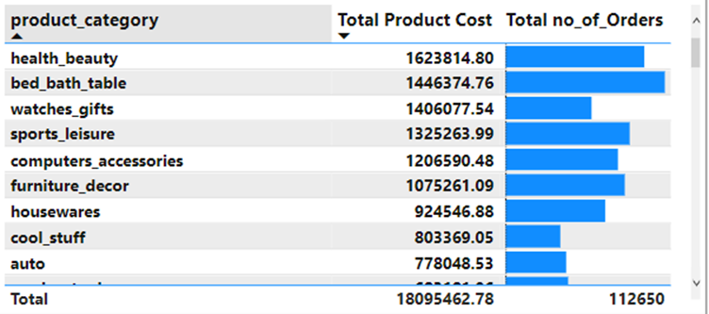
5.1
What was the most and less profitable product category ?

Slide 10
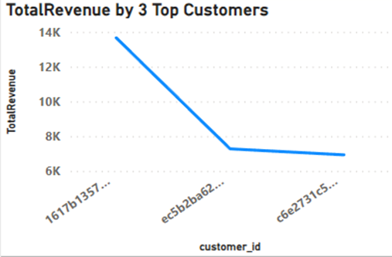
5.2
Who were the 3 top customers purchased from our store?

Slide 11
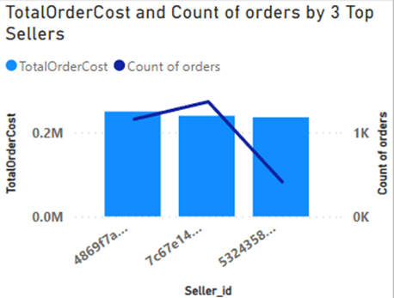
5.3
Who were the 3 best sellers made the biggest number of orders?

Slide 12
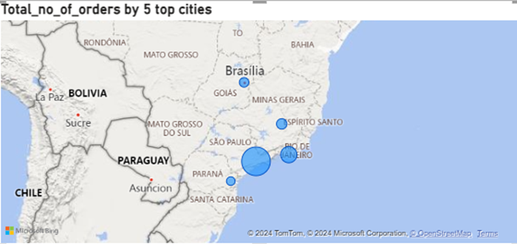
5.4
Which city that had the biggest number of orders?

Slide 13
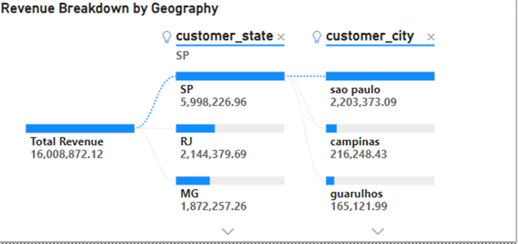
5.5
Which state that made the highest revenues?

Slide 14
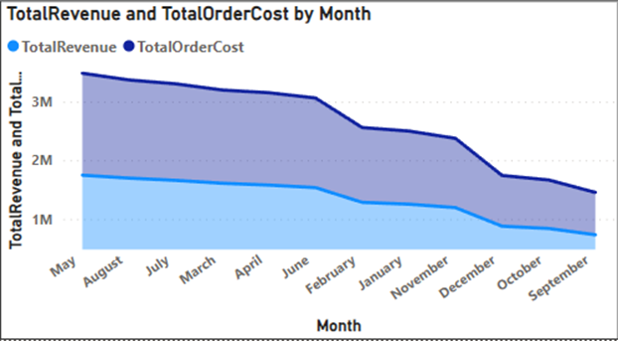
5.6
What was the highest and lowest month in revenues?

Slide 15
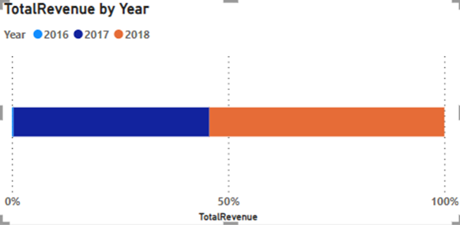
5.7
Which year that contributed most to total revenue?

Slide 16
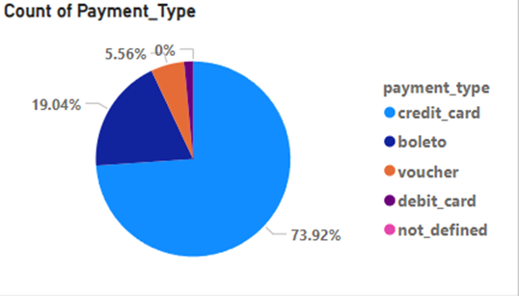
5.8
What was the most and less popular type of payment?

Slide 17
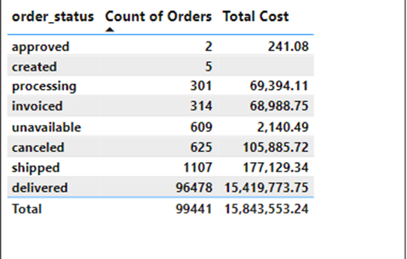
5.9
What was the value of orders canceled and unavailable?

Slide 18
INSIGHTS
6.1
1- The store made the highest revenues in 2018.
2- Revenues fluctuated through months but May was the highest in revenues while September was the lowest.
3-While the number of orders for bed_bath_table was larger than that for health_beauty category but health_beauty achieved the highest revenues.
4- The store got the highest revenues from SP state and Sao Paulo contributed the most in that revenue.

Slide 19
INSIGHTS
6.2
5-The orders canceled were 625 orders and cost the store not a small amount 105,886.
6-The 2 most popular type of payments were credit card and boleto.
7-Sub-categories like security and services and fashion_childerns_clothes achieved the least revenues while the cost per order was not small.

Slide 20
RECOMMENDATIONS
7
1-Making special marketing campaigns through months that had less revenues like September and October.
2-As credit card and boleto are popular in Brazil the store can offer discounts or special promotions for payments made through these methods to increase sales.
3-The store needs to make marketing campaigns at states that purchased less like RR and AP.
4-There are product sub-categories that had lower order numbers and lower cost per order like cds_dvds_musicals ,store can market these products more to get more profit.

Slide 21



THANK YOU
CONNECT WITH ME.
www.linkedin.com/in/salwasayed
salwahassen527@gmail.com

